Slide 1
MIR mechanisms against Botrytis cinerea in tomato: omics integration
14/09/23
Maria M., Maja Z., Marko P., Ziva R., Carissa R., Paloma S., Julia F., Kristina G., Victoria P. and Victor F.

Slide 2
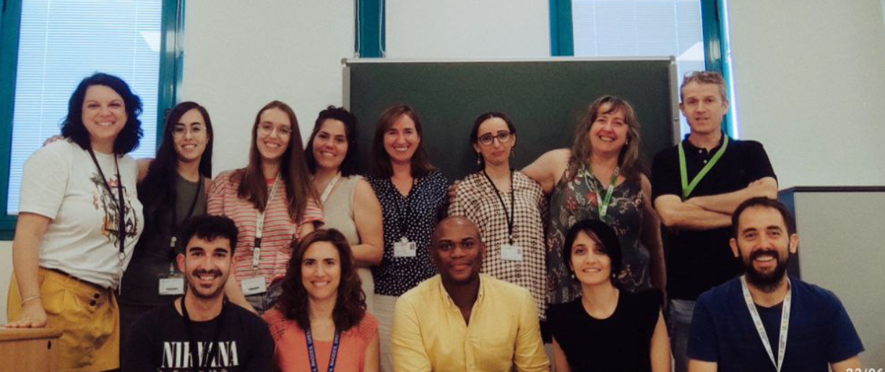
Plant immunity and Biochemistry group
(Universitat Jaume I)
Induced resistance against pathogens
Plant-arthropod interactions
Priming
Hormonal metabolism
Metabolomics
https://nitropriming.wordpress.com/
Research lines?

Slide 3
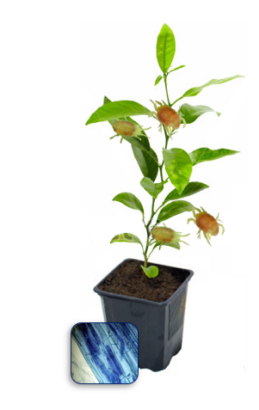
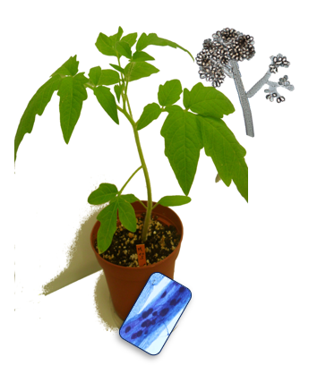
MIR mechanisms against Botrytis cinerea in tomato and exploration on Tetranychus urticae in citrus
Maria’s thesis
Citrus - Tetranychus urticae
Tomato – Botrytis cinerea

Slide 4
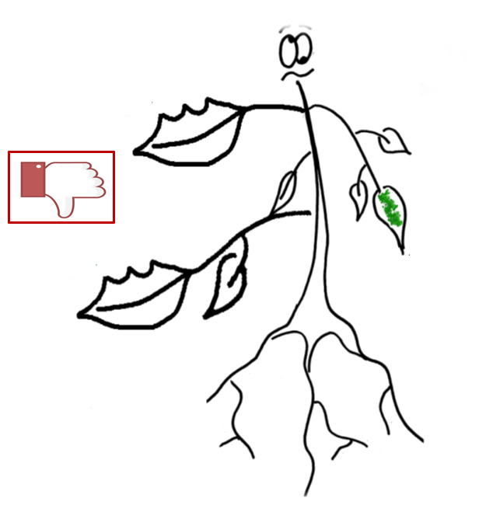
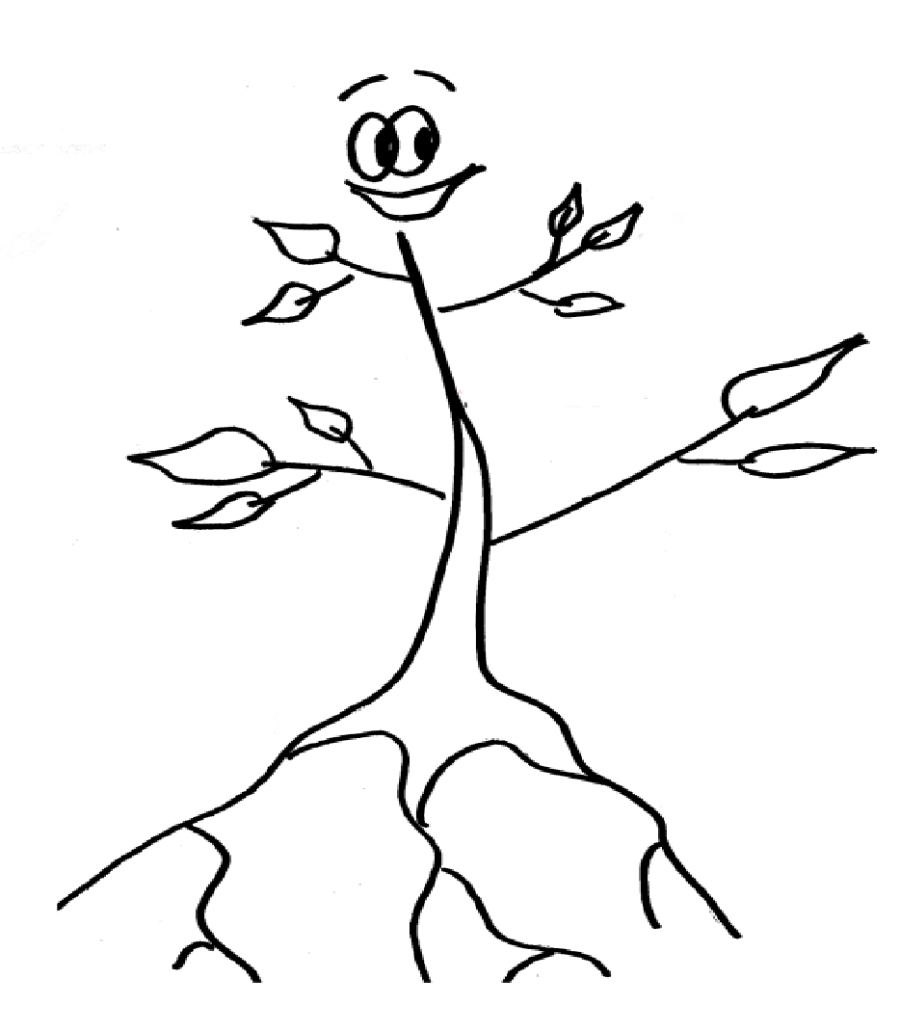

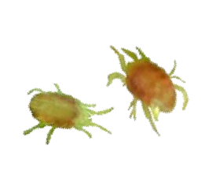
Chemicals
Beneficial microorganisms
Volatiles
INDUCED RESISTANCE

Slide 5
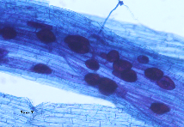
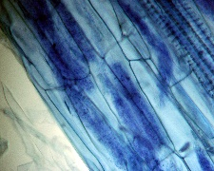
Arbuscular Mycorrhizal Fungi
JA-dependent responses
MYCORRHIZA-INDUCED RESISTANCE
Rhizophagus irregularis

Slide 6
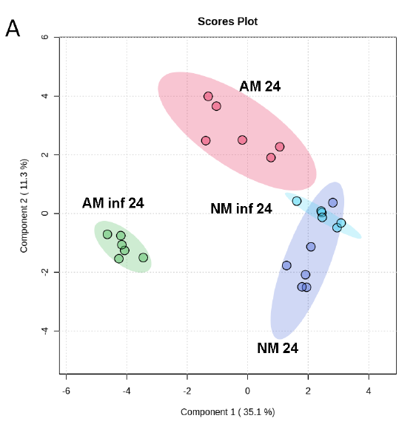
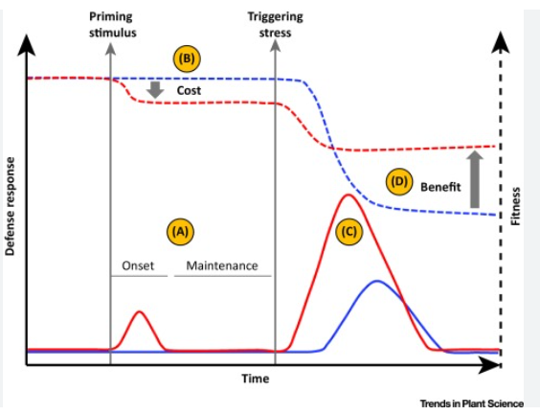
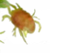
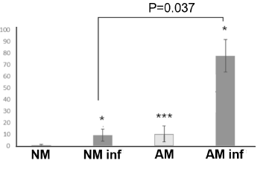
What is Priming?
Primed plants respond after a “real” attack faster and stronger
Less fitness cost
Priming profile
Priming stimulus: Chemicals, VOCs, previous attacks, constitutive priming
Priming of PR3 in mycorhizal plants

Slide 7
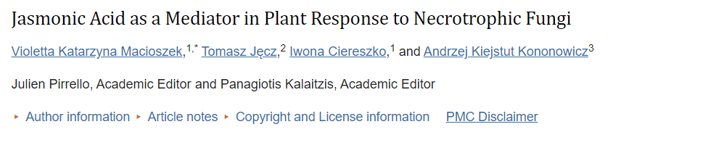
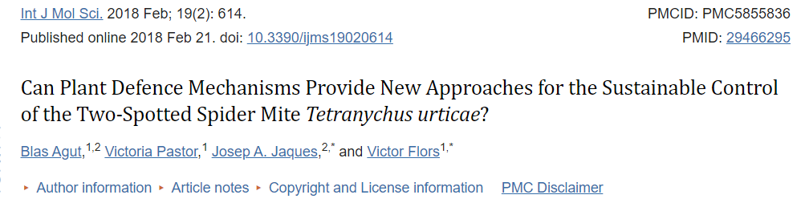
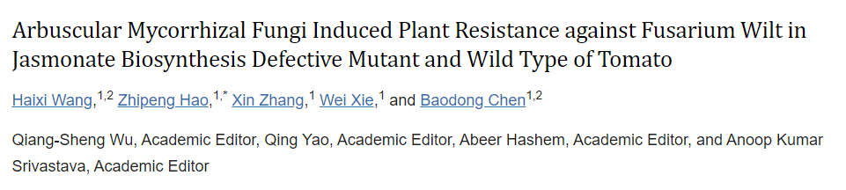
Maria’s thesis
JA mediates defense against necrotrophs
JA mediates defense against mites
JA-DEPENDENT RESPONSES
MIR is JA-dependent

Slide 8
Maria’s thesis
Could MIR be effective in two different pathosystems that depends on JA-signaling pathway?
Citrus - Tetranychus urticae
Tomato – Botrytis cinerea
mite
necrotroph

Slide 9
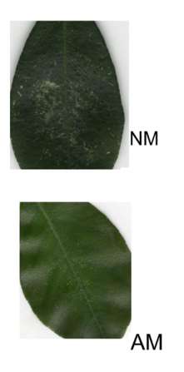
Chapter 1. and 2. MIR in citrus against Tetranychus urticae
Maria’s thesis
Completed
Chapter 1. Sour Orange (resistant genotype)
Chapter 2. Cleopatra mandarin (susceptible genotype)
MIR enhance:
Antibiosis
MIR enhance:
Antibiosis
Antixenosis
Indirect responses
Systemic responses
VOCs
Priming of JA-dependent responses
Functional characterization of priming compounds with antimicrobial properties
Priming of JA-dependent responses
ABA-dependent responses
Flavonoids essential for MIR and symbiosis
Also tested in field conditions!
(Manresa-Grao et al. 2022, Front. Plant Sci.) PON DOI
(Manresa-Grao et al. 2023, under review)

Slide 10
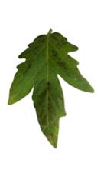

Maria’s thesis
CHAPTER 3: MIR PERCEPTION AGAINST BOTRYTIS IS MEDIATED BY SYTEMIN
Almost complete
CHAPTER 4: OMICS INTEGRATION
On going
*
AM plants display lower fungal biomass and cell death

Slide 11

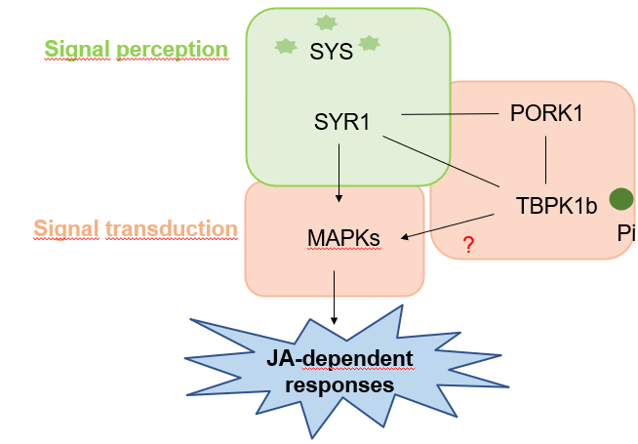
CHAPTER 3: MIR PERCEPTION AGAINST BOTRYTIS IS MEDIATED BY SYTEMIN
Necrotrophs
Chewing insects
Wounding
Systemin: DAMP from Solanaceae family
MIR is also JA-dependent
Notes:
Systemin, as a i said before, is a phytocitokine released from its precursor (PROSYSTEMIN) upon damage.
Systemin perception and signaling regulates the biosynthesis of jasmonic acid and induces the activation of different defense genes.
This signal mediates plant resistance against chewing insectss, necrotrophs and mechanical damaging.
In other to dilucidate the early signaling events that occurs in MIR, we study the posible implication of systemin in MIR.
First of all, we measure the levels of systemin in NM and AM plan before and after infection.
We obserb that systemin is accumulated after infection. Interestyingly, am plants present higher levels of systemin that control plants.

Slide 12
CHAPTER 3: MIR PERCEPTION AGAINST BOTRYTIS IS MEDIATED BY SYTEMIN
Mycorrhizal plants displayed higher basal levels of systemin compared to control plants.
A priming profile in SYR1 (systemin receptor) and PORK1 (SYR1 co-receptor) gene expression is observed.
SYR1-silenced (VIGS) mycorrhizal plants displayed higher disease symptoms, indicating that MIR is mediated by systemin.
A faster activation of MAPKs (VIGS) cascade is essential for MIR.
Priming of JA-ile.

Slide 13
STAY IN LJUBLJANA
CHAPTER 4: MIR MECHANISMS AGAINST B. CINEREA IN TOMATO PLANTS
AIM OF THIS STUDY
Find connections between different omic levels to understand and explain why mycorrizhal plants are more resistant to Botrytis cinerea infection

Slide 14

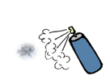
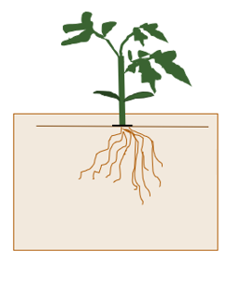
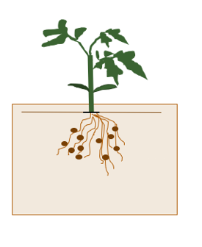
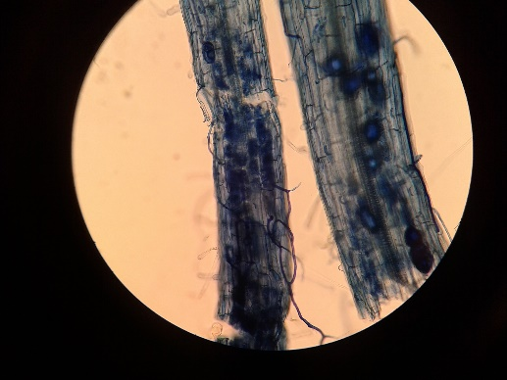
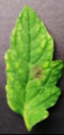
EXPERIMENTAL DESIGN
NECROTROPHIC FUNGI
B.cinerea infection in 3rd and 4th leaves by spray
Castlemart
Functional symbiosis in 4-5 weeks
AMF inoculation
10 days-old plants
Rhizophagus irregularis
BENEFICIAL ARBUSCULAR MYCORRHIZAL FUNGI
Sampling 3rd and 4th leaves
Notes:
In this work, we have two different timepoints: 6 and 24 hpi.

Slide 15
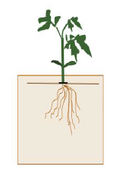
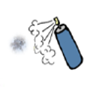
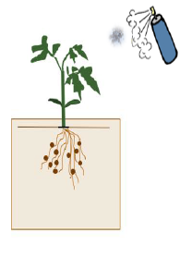
4 treatments
Contrasts for omics
Contrast
AM inf/AM
AM/NM
AM inf/NM inf
AM inf/NM
NM inf/NM
Control plant
(NM)
Control infected
(NM inf)
AM plants prepare itselfs for futher attacks
These 2 contrasts could explain the enhanced resistance!
Mycorrhizal plant
(AM)
Mycorrhizal infected
(AM inf)

Slide 16
Hours post infection
Analysis | 24 hpi | 48 hpi
RNA-seq | Yes | Yes
Proteome | Yes | No
Phosphoproteome | Yes | No
Enzymome | Yes | Yes
Metabolome | Yes | Yes
We chose 24 hpi for further analyses
Analysis | Nº replicates
RNA-seq | 3
Proteome | 3
Phosphoproteome | 4 (AM only 3)
Enzymome | 6
Metabolome | 6
Every replicate contains 3 plants

Slide 17
RNA-seq : Mapping to ITAG 4.1
Differential expressed genes
Enrichment analyses
Proteomics and Phosphoproteomics:
Differential expressed proteins
Enrichment analyses
Enzymomics and metabolomics:
LogFC and P-values
DiABLO: 3 levels (Pph, Enz and Met)
Networks

Slide 18

RNA-seq
PROBLEMS: ANNOTATION ITAG 4.0
MAPPED AND CHANGED TO ITAG 4.1
(Maria M. and Marko P.)
24 and 48 hpi
Who performed the analysis:
HTML DEGs
https://github.com/NIB-SI/UJI-Omics-phd/blob/main/_I_UJI-Omics-phd/_S_multiOmicsIntegra/_A_02_DEtranscriptomics-R/scripts/01_DE.html
TABLE DEGs
https://github.com/NIB-SI/UJI-Omics-phd/blob/main/_I_UJI-Omics-phd/_S_multiOmicsIntegra/_A_02_DEtranscriptomics-R/output/DEGS%20for%20network.xlsx
TABLE ENRICHMENT
https://github.com/NIB-SI/UJI-Omics-phd/blob/main/_I_UJI-Omics-phd/_S_multiOmicsIntegra/_A_03_EnrichmentTranscriptomics-R/output/GSEA_few-cols.x_newlsx.xlsx

Slide 19



DIFFERENTIAL EXPRESSED GENES (DEGS)
(Maria M., Marko P., Maja and Pedro)
EdgeR
limma
Input
Output
Raw counts
Normalized counts
DEGs
LogFC
P-values
Filter low-expressed genes
Normalize data
Limma-Voom method
Contrast from Linear Model
Ebayes statistics
ENRICHMENT ANALYSIS
Input
Ouput
Normalized counts
(from edgeR)
Classes of genes over-repressented

Slide 20
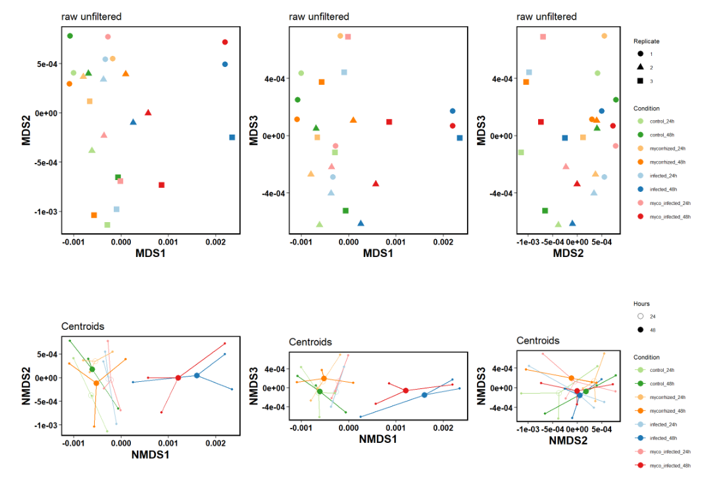
MULTIDIMENSIONAL SCALING AND SPIDERPLOTS RAW DATA
For 24 and 48 hpi because we didn’t observe changes in 24 hpi. Delay??
24 and 48 hpi
Infection has the higher impact

Slide 21
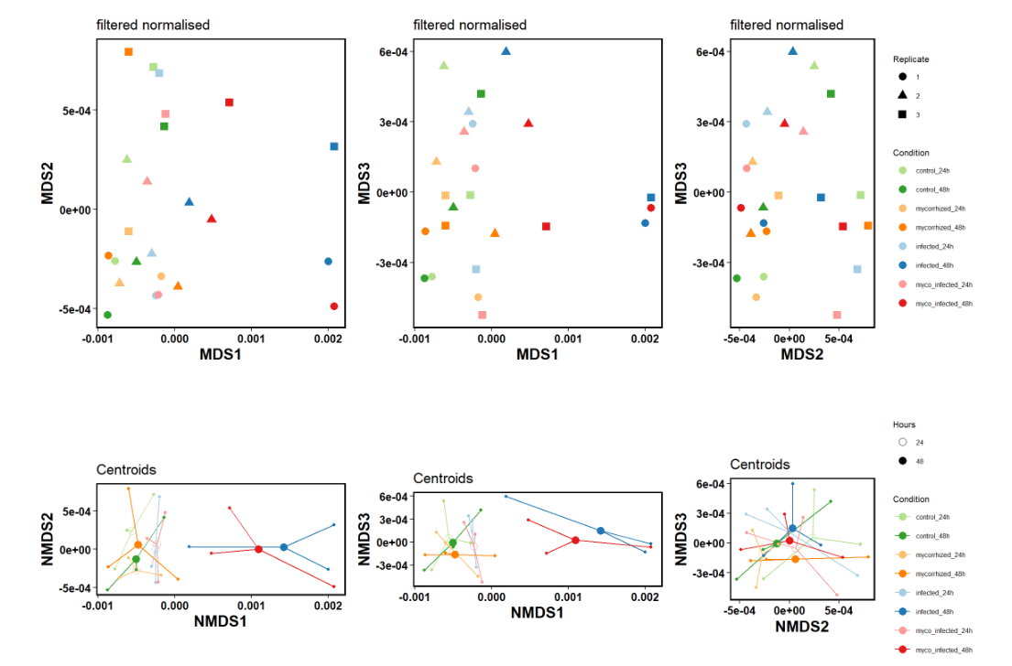
MULTIDIMENSIONAL SCALING AND SPIDERPLOTS NORMALIZED DATA
24 and 48 hpi
Infection has the higher impact

Slide 22
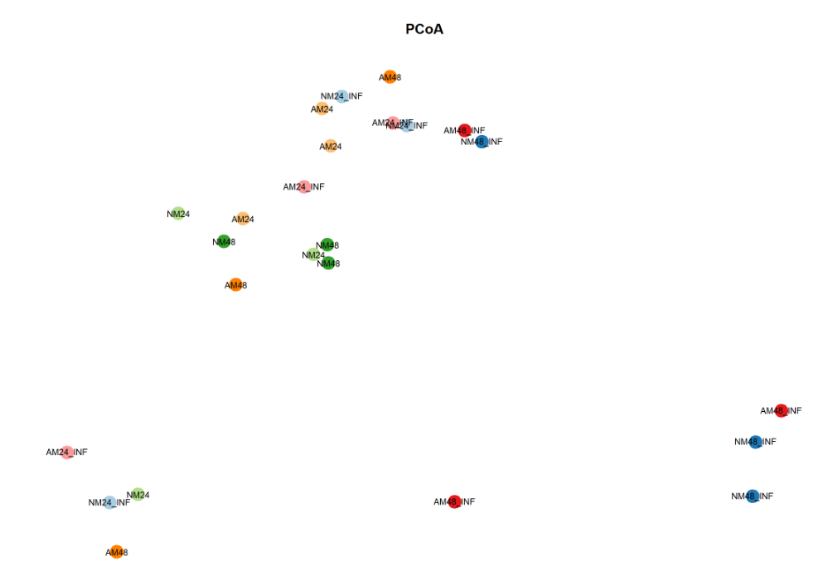
24 and 48 hpi
PRINCIPAL COORDINATED ANALYSIS
Too much variability between biological replicates
Euclidean distance

Slide 23
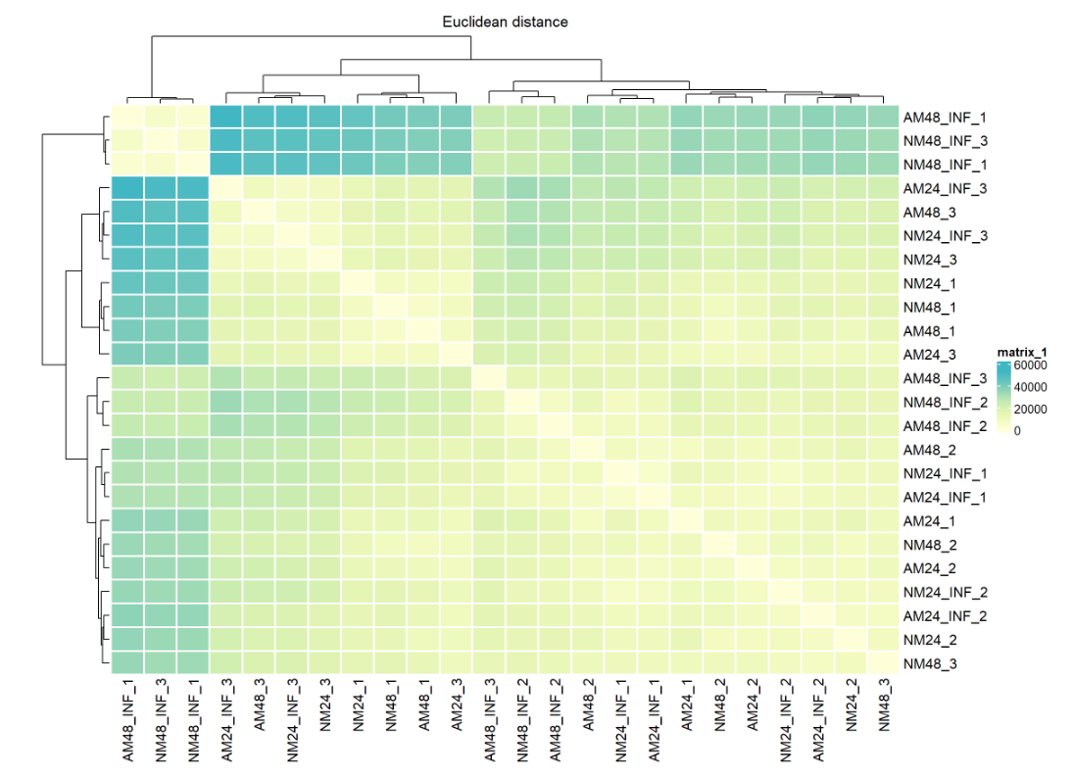
24 and 48 hpi
Too much variability between biological replicates but most of infected conditions clustered together
Heatmap

Slide 24
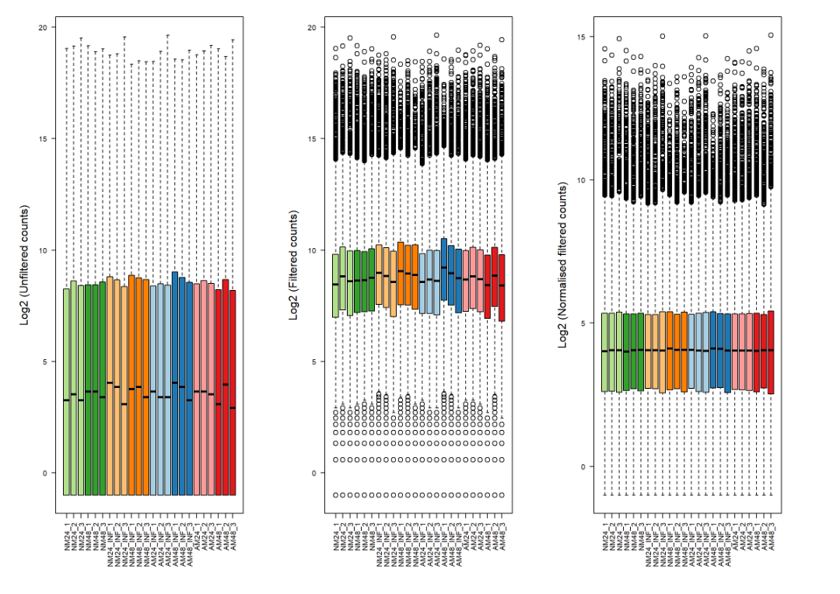
DENSITY PLOTS
Log2 filtered and normalize
Log2 unfiltered
Log2 filtered

Slide 25
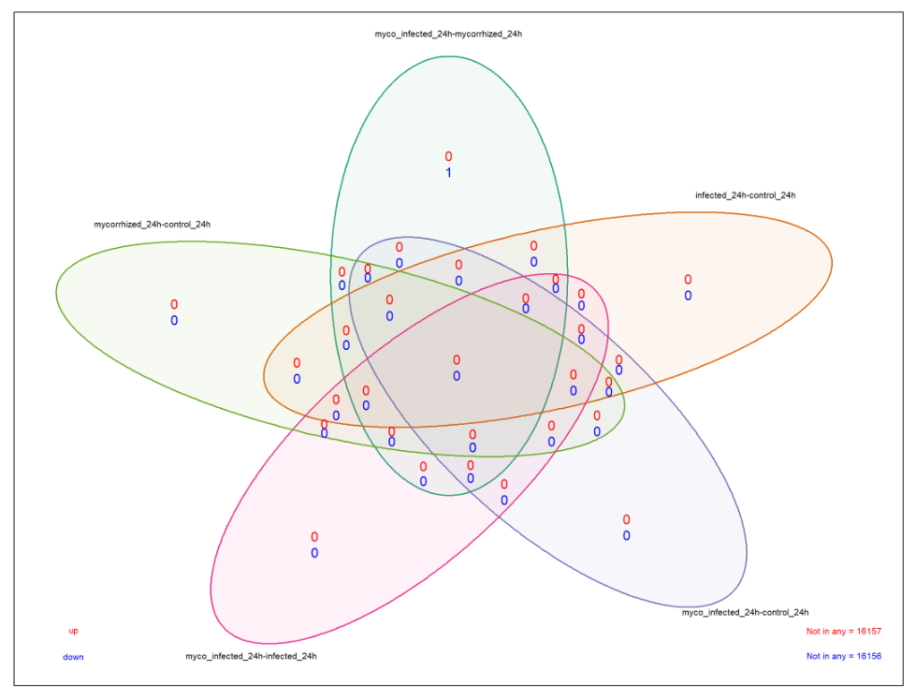
High variability between replicates at 24 hpi
VENN DIAGRAM
Adj. P almost 1
24 hpi

Slide 26
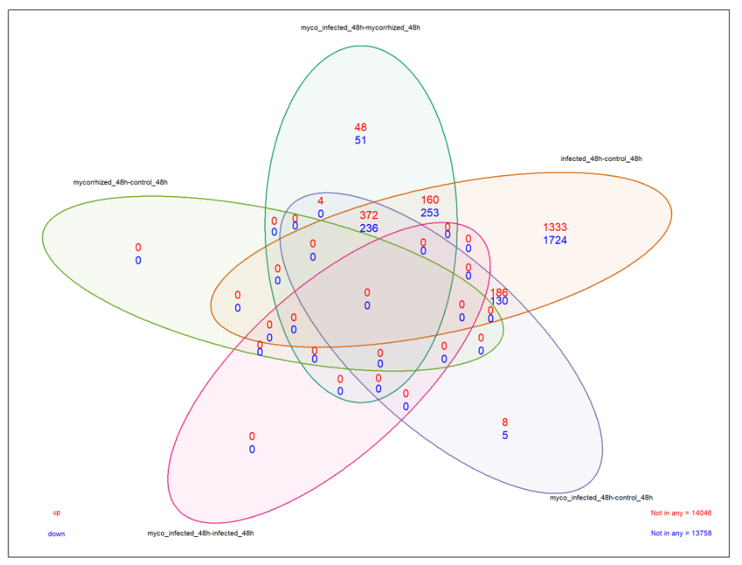
VENN DIAGRAM
48 hpi
Could these changes explain the enhance resistance?

Slide 27
48 hpi
Genes filtered by |logFC |>1.5 (<-1.5) and FDR>0.5
geneID | Shortnames | geneDesc | AM48-NM48 | AMinf48-AM48 | NMinf48-NM48 | AMinf48-NM48 | AMinf48-NMinf48
Solyc01g080800.3.1 | BSP | Basic secretory family protein (AHRD V3.3 *** A0A2K3LW23_TRIPR)
Solyc01g080800.3.2 | OM9-2-like | mitochondrial import receptor subunit TOM9-2-like (AHRD V3.3 *** A0A1S3Y998_TOBAC)
Solyc01g080800.3.3 | Unk | Unknown protein
Solyc01g080800.3.4 | ET-TF | Ethylene-responsive transcription factor (AHRD V3.3 *** A0A2G2X630_CAPBA)

Slide 28
24 hpi
logFC<-1.5
Enrichment filtered by |logFC |>1.5 (<-1.5) and FDR>0.5
logFC>1.5
FUCTION | AM/NM | AM inf/ AM | AM inf/NM | AM inf/NM inf | NM inf/NM
CHROMATIN ORGANISATION.POST-TRANSLATIONAL HISTONE MODIFICATION
RNA BIOSYNTHESIS
RNA PROCESSING. RNA MODIFICATION
RIBOSOME BIOGENESIS.SMALL RIBOSOMAL SUBUNIT (SSU).SSU PROTEOME
AMINOACYL-TRNA SYNTHETASE ACTIVITIES
PRE-INITIATION COMPLEX (PIC) MODULE.
PROTEIN BIOSYNTHESIS. RIBOSOME BIOGENESIS
PROTEIN MODIFICATION
PHOSPHORYLATION
CELLULAR RESPIRATION.OXIDATIVE PHOSPHORYLATION.NADH DEHYDROGENASE COMPLEX
CHLOROPLAST.INNER ENVELOPE TIC TRANSLOCATION SYSTEM
LIPID METABOLISM
ISOMERASES

Slide 29
24 hpi
Enrichment filtered by |logFC |>1.5 (<-1.5) and FDR>0.5
FUCTION | AM/NM | AM inf/ AM | AM inf/NM | AM inf/NM inf | NM inf/NM
PHOTOSYNTHESIS.CALVIN CYCLE.RIBULOSE-1,5-BISPHOSPHAT CARBOXYLASE/OXYGENASE (RUBISCO) ACTIVITY
PROTEIN BIOSYNTHESIS.AMINOACYL-TRNA SYNTHETASE ACTIVITIES
PROTEIN BIOSYNTHESIS.ORGANELLE MACHINERY
CAROTENOID BIOSYNTHESIS
MITOCHONDRIAL ISC SYSTEM
PROTEIN TRANSLOCATION.CHLOROPLAST
SOLUTE TRANSPORT
SHIKIMATE GROUP AMINO ACID BIOSYNTHESIS
MEVALONATE PATHWAY
OXIDOREDUCTASES
TRANSFERASES
CELL WALL ORGANISATION.LIGNIN BIOSYNTHESIS
VESICLE TRAFFICKING
ENDOPLASMIC RETICULUM.CO-TRANSLATIONAL INSERTION SYSTEM
REDOX HOMEOSTASIS

Slide 30
48 hpi
Enrichment filtered by |logFC |>1.5 (<-1.5) and FDR>0.5
FUCTION | AM/NM | AM inf/ AM | AM inf/NM | AM inf/NM inf | NM inf/NM
PROTEIN BIOSYNTHESIS.TRANSLATION ELONGATION
TERPENOIDS
CHROMATIN STRUCTURE
NUCLEOSOME REMODELING
CELL DIVISION
DNA DAMAGE RESPONSE
RNA BIOSYNTHESIS
RNA PROCESSING.MRNA SILENCING
RNA PROCESSING.RNA MODIFICATION
PROTEIN BIOSYNTHESIS.RIBOSOME BIOGENESIS.RRNA MATURATION
PHOSPHORYLATION.CMGC PROTEIN KINASE SUPERFAMILY
PROTEIN HOMEOSTASIS.UBIQUITIN-PROTEASOME SYSTEM
PROTEIN TRANSLOCATION.NUCLEAR PORE COMPLEX (NPC)
TRANSITION METAL HOMEOSTASIS
EXTERNAL STIMULI RESPONSE.VIRUS
PHOSPHOINOSITIDE HOMEOSTASIS
PYRIMIDINES
MEVALONATE PATHWAY

Slide 31
PROTEOMICS AND PHOSPHOPROTEOMICS
24 hpi
Who performed the analysis:
Prof. Dr. Roque Bru Martínez
Proteomics and functional genomics of plants.
University of Alicante (Spain)

Slide 32
PROTEOME (Pro)
PHOSPHOPROTEOME (Pph)
DEP: DIFFERENTIAL EXPRESSED PROTEINS
(Maria M., Marko P., Maja and Pedro)
limma
Input
Filter on missing values
Normalize data
Log2/log10 transformation
Output
Raw measurements
Normalized data
DEPs
LogFC
P-values
DEP
Link DEP: https://bioconductor.org/packages/release/bioc/vignettes/DEP/inst/doc/DEP.html
ENRICHMENT ANALYSIS
Output
Input
Normalized levels
Classes of proteins over-repressented

Slide 33
PROTEOMICS (Pro)
HTML DEPs https://github.com/NIB-SI/UJI-Omics-phd/blob/main/_I_UJI-Omics-phd/_S_multiOmicsIntegra/_A_04_EnrichmentProteomics-R/PROTEOMICS/Scripts/01_DEP-DE-proteomics_modified-for-Maria.html
Table DEPs: https://github.com/NIB-SI/UJI-Omics-phd/blob/main/_I_UJI-Omics-phd/_S_multiOmicsIntegra/_A_04_EnrichmentProteomics-R/PROTEOMICS/output/GSEA_few-cols%20(proteomics).xlsx
Table enrichment: https://github.com/NIB-SI/UJI-Omics-phd/blob/main/_I_UJI-Omics-phd/_S_multiOmicsIntegra/_A_04_EnrichmentProteomics-R/PROTEOMICS/output/DEP%20for%20network_proteomics.xlsx

Slide 34
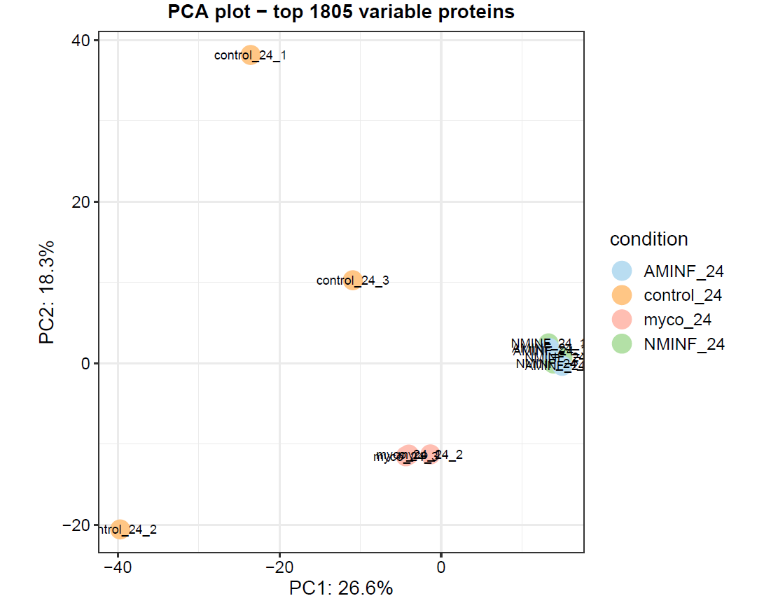
Proteomics
PRINCIPAL COMPONENT ANALYSIS
Infected plants have the same behaviour
Symbiosis has a huge impact on proteome

Slide 35
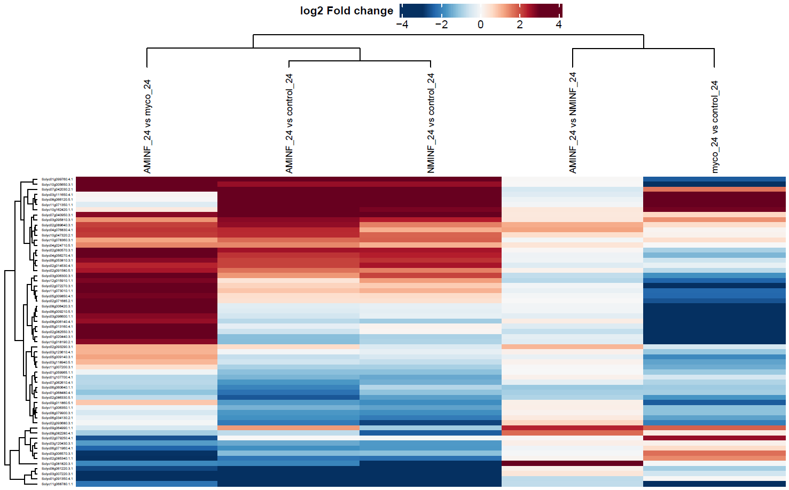
Proteomics
HEATMAP WITH CLUSTERING
Symbiosis also has a huge impact on proteome
Induced resistance
Priming?

Slide 36
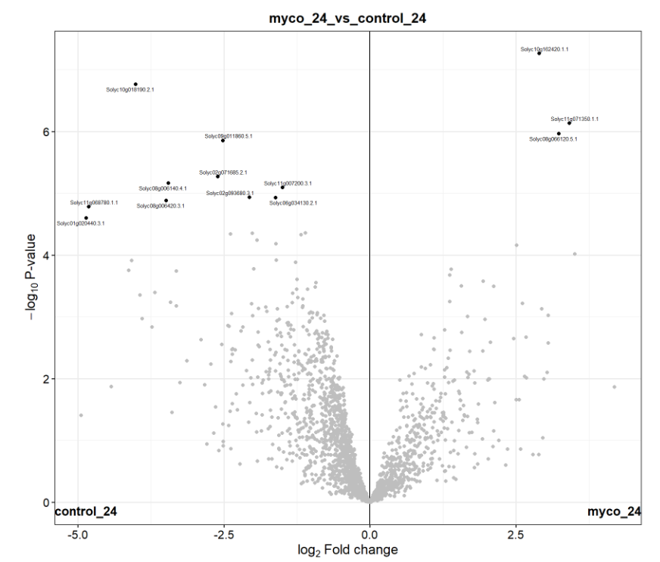
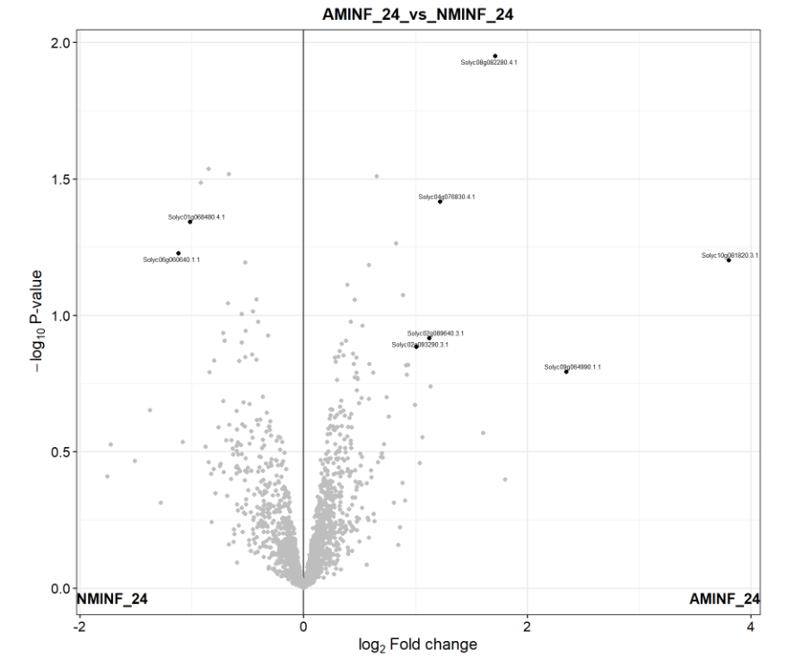
Proteomics
VOLCANO PLOTS
Candidates for explaining the enhanced resistance

Slide 37
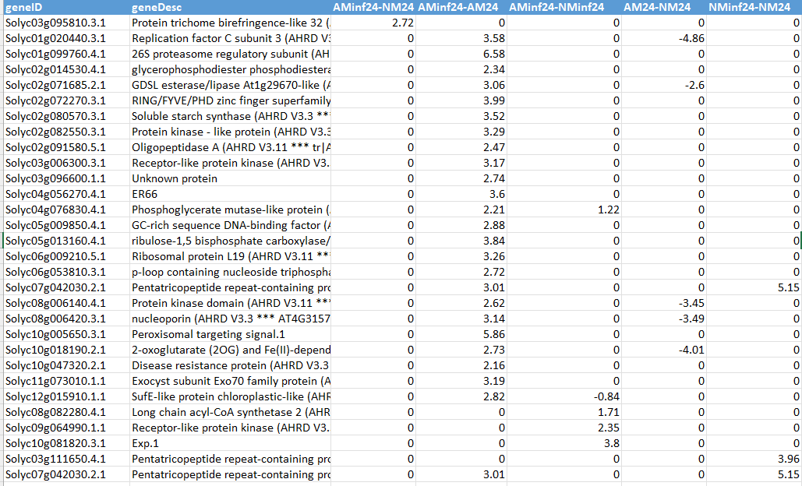
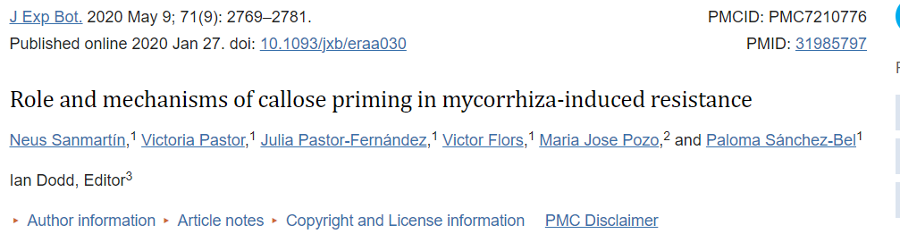
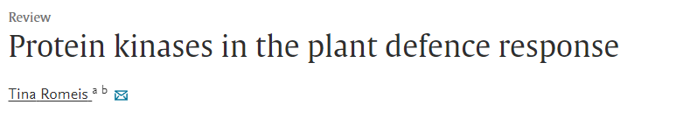
Proteomics
UPREGULATED PROTEINS WITH logFC>1.5 AND p-value>0.05
10.1093/jxb/eraa030
Starch is involved in callose accumulation in MIR
https://doi.org/10.1016/S1369-5266(00)00193-X

Slide 38
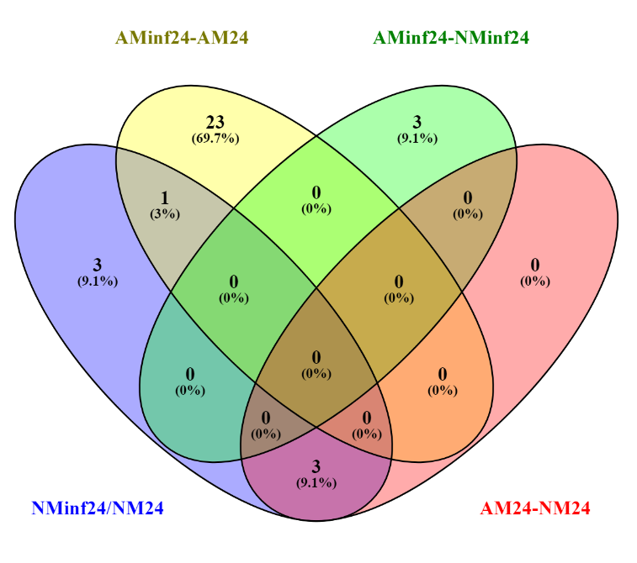
Proteomics
Venn diagram upregulated proteins using LogFC>1 p<0.05
MIR

Slide 39
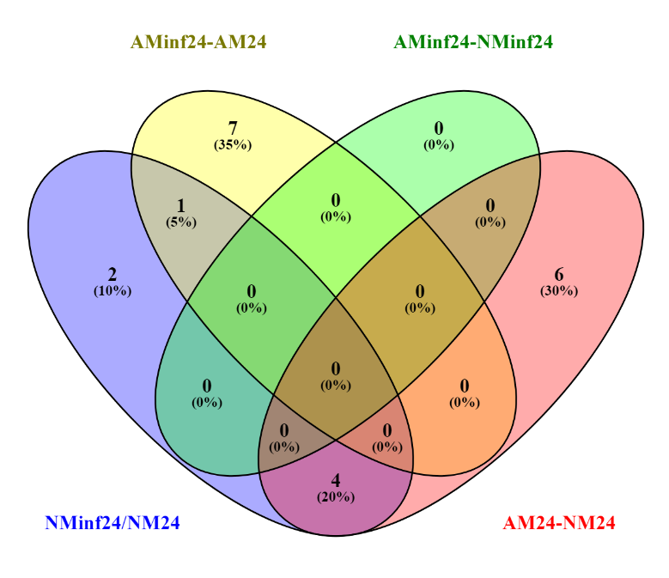
Proteomics
Venn diagram downregulated proteins using LogFC<-1 p<0.05

Slide 40
Accumulated proteins filtered by |logFC |>1.5 (<-1.5) and FDR>0.5
Proteomics
ID | Shortname | Function | Description | AM/NM | AM inf/AM | AM inf/NM | AM inf/ NM inf | NM inf/NM
Solyc03g095810.3.1 | TBL32 | Cell wall organisation | Protein trichome birefringence-like 32
Solyc09g011860.5.1 | O-FucT | Cell wall organisation | GDP-fucose protein O-fucosyltransferase protein
Solyc01g020440.3.1 | RFC3 | Cell division | Replication factor C subunit 3
Solyc01g099760.4.1 | PSMC | Protein homeostasis | 26S proteasome regulatory subunit
Solyc02g080570.3.1 | SS | Carbohydrate metabolism | Soluble starch synthase
Solyc02g082550.3.1 | Pka | Transferases | Protein kinase - like protein
Solyc02g091580.5.1 | OP-A | Protein homeostasis | Oligopeptidase A
Solyc03g006300.3.1 | RLK | Signalling peptides. NCRP (non-cysteine-rich-peptide) | Receptor-like protein kinase
Solyc04g056270.4.1 | ER66 | RNA biosynthesis | ER66
Solyc05g009850.4.1 | GCFC2 | RNA processing | GC-rich sequence DNA-binding factor
Solyc02g085340.1.1 | GRAS | RNA biosynthesis | Transcription factor GRAS
Solyc01g091350.4.1 | KU80 | DNA damage response | ATP-dependent DNA helicase 2 subunit KU80
Solyc05g013160.4.1 | RBCMT_PEA | Transferases | ribulose-1,5 bisphosphate carboxylase/oxygenase large subunit N-methyltransferase, chloroplastic
Solyc08g006140.4.1 | PKb | Transferases | Protein kinase domain
Solyc06g009210.5.1 | RPL19 | Ribosome biogenesis (LSU) | Ribosomal protein L19
Solyc11g007200.3.1 | HIPPs | Nutrient uptake | Heavy metal-associated isoprenylated plant protein 26
Solyc11g006350.1.1 | ATCase | Nucleotide metabolism | aspatate carbamoyltransferase
Solyc10g005650.3.1 | PTS1 | Protein translocation | Peroxisomal targeting signal.1
Solyc10g018190.2.1 | 2OG-FeII | Oxidoreductases | 2-oxoglutarate (2OG) and Fe(II)-dependent oxygenase superfamily protein

Slide 41
Accumulated proteins filtered by |logFC |>1.5 (<-1.5) and FDR>0.5
Proteomics
ID | Shortname | Function | Description | AM/NM | AM inf/AM | AM inf/NM | AM inf/ NM inf | NM inf/NM
Solyc02g014530.4.1 | GDPDL6-l | Not assigned | glycerophosphodiester phosphodiesterase GDPDL6-like
Solyc02g071685.2.1 | GDSL | Not assigned | GDSL esterase/lipase At1g29670-like
Solyc02g072270.3.1 | Znf_RING/FYVE/PHD | Not assigned | RING/FYVE/PHD zinc finger superfamily protein
Solyc03g096600.1.1 | unk | Not assigned | Unknown protein
Solyc04g076830.4.1 | PGAM | Not assigned | Phosphoglycerate mutase-like protein
Solyc03g111650.4.1 | PPRa | Not assigned | Pentatricopeptide repeat-containing protein, chloroplastic
Solyc02g086330.5.1 | HEATRL | Not assigned | HEAT repeat-containing protein-like
Solyc07g062610.4.1 | DJ-1-like | Not assigned | Protein DJ-1-like protein B
Solyc03g007220.3.1 | RPK1 | Not assigned | Membrane receptor-like protein.1
Solyc02g079250.4.1 | IMPase | Not assigned | Inositol monophosphatase family protein (3',5'-bisphosphate nucleotidase)
Solyc08g006420.3.1 | Nup | Not assigned | nucleoporin
Solyc10g047320.2.1 | DR | Not assigned | Disease resistance protein
Solyc06g053810.3.1 | P-loop NTPase | Not assigned | p-loop containing nucleoside triphosphate hydrolases superfamily protein
Solyc07g042030.2.1 | PPRb | Not assigned | Pentatricopeptide repeat-containing protein
Solyc09g064990.1.1 | RLKs | Not assigned | Receptor-like protein kinase
Solyc03g006570.3.1 | CHR28 | Chromatin organisation | SNF2 domain-containing protein / helicase domain-containing protein / zinc finger protein-like protein
Solyc03g120430.3.1 | GLYK | Photosynthesis | D-glycerate 3-kinase
Solyc06g071960.4.1 | NDPK | Transferases | Nucleoside diphosphate kinase
Solyc11g073010.1.1 | Exo70 | Vesicle trafficking | Exocyst subunit Exo70 family protein
Solyc12g015910.1.1 | SufE-like-1 | Coenzyme metabolism | SufE-like protein chloroplastic-like
Solyc08g082280.4.1 | ACSL2 | Ligases | Long chain acyl-CoA synthetase 2
Solyc10g081820.3.1 | DPH3 | Protein biosynthesis | Exp.1

Slide 42
Proteomics
logFC<-1.5
Enrichment filtered by |logFC |>1.5 (<-1.5) and FDR>0.5
logFC>1.5
Fuction | AM/NM | AM inf/AM | AM inf/NM | AM inf/NM inf | NM inf/NM
OXIDOREDUCTASE ACTING ON PAIRED DONOR (O2)
CELL WALL ORGANISATION
TRANSFERASES
RNA PROCESSING
RNA PROCESSING.ORGANELLE MACHINERY
PHOSPHORYLATION
PHOSPHORYLATION.TKL PROTEIN KINASE SUPERFAMILY
TRANSFERASE OF ALKYL OR ARYL GROUP, OTHER THAN METHYL GROUP
TRANSFERASE OF PHOSPHORUS-CONTAINING GROUP

Slide 43
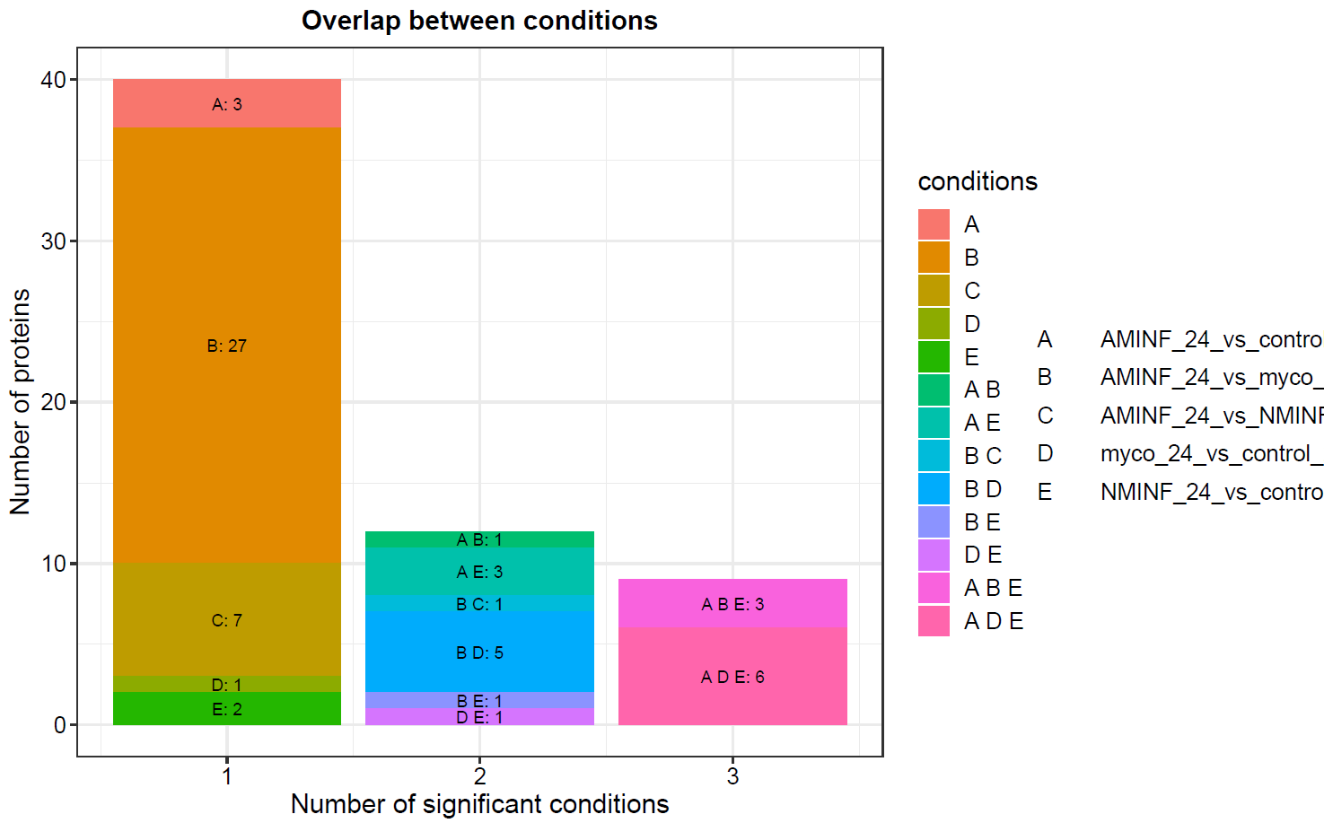
Proteomics
Frequency plot of significant proteins between contrasts/conditions

Slide 44
PHOSPHOPROTEOMICS (Pph)
HTML DEPs https://github.com/NIB-SI/UJI-Omics-phd/blob/main/_I_UJI-Omics-phd/_S_multiOmicsIntegra/_A_04_EnrichmentProteomics-R/PHOSPHOPROTEOMICS/scripts/01_DEP-DE-prot_modified-for-Maria.html
Table DEPS: https://github.com/NIB-SI/UJI-Omics-phd/blob/main/_I_UJI-Omics-phd/_S_multiOmicsIntegra/_A_04_EnrichmentProteomics-R/PHOSPHOPROTEOMICS/output/DEP%20for%20network.xlsx
Table enrichment https://github.com/NIB-SI/UJI-Omics-phd/blob/main/_I_UJI-Omics-phd/_S_multiOmicsIntegra/_A_04_EnrichmentProteomics-R/PHOSPHOPROTEOMICS/output/GSEA_few-cols%20(phosphoproteomics).xlsx

Slide 45
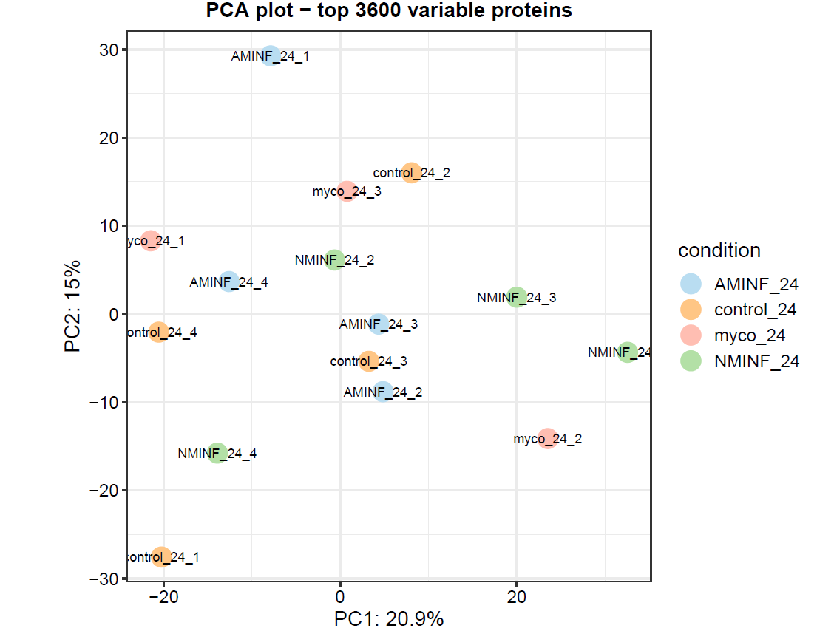
Phosphoproteome
PRINCIPAL COMPONENT ANALYSIS
High variability but infested plants are close

Slide 46
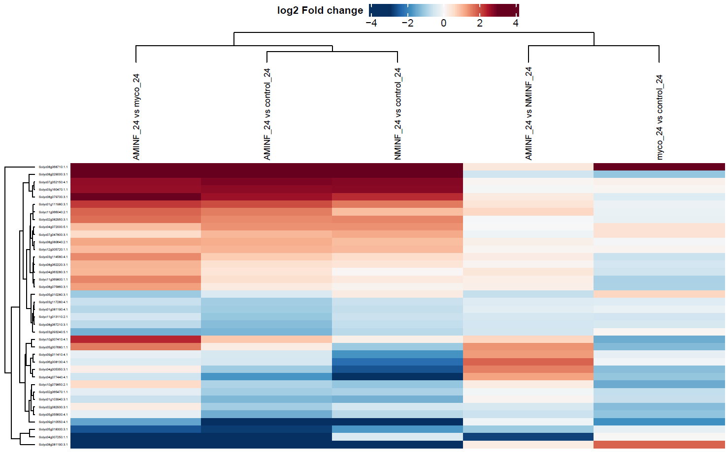
Phosphoproteome
HEATMAP WITH CLUSTERING
Symbiosis has a huge impact on phosphoproteome
Are AM plants preparing itselfs for futher stresses?
Priming?
Priming?

Slide 47
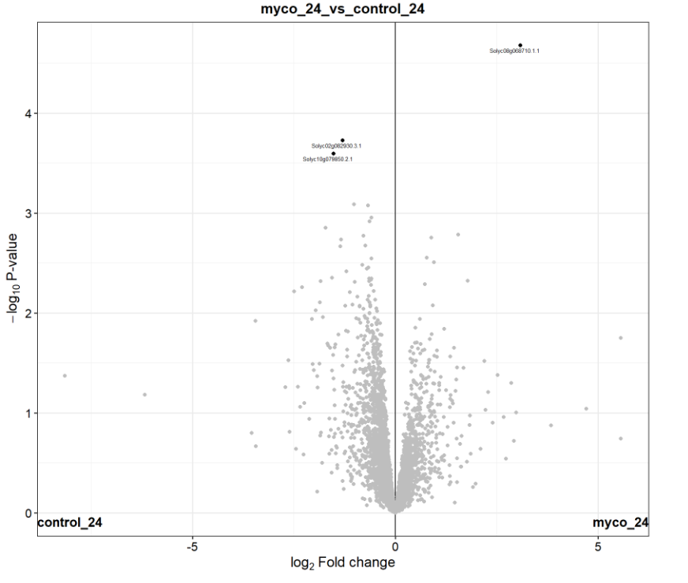
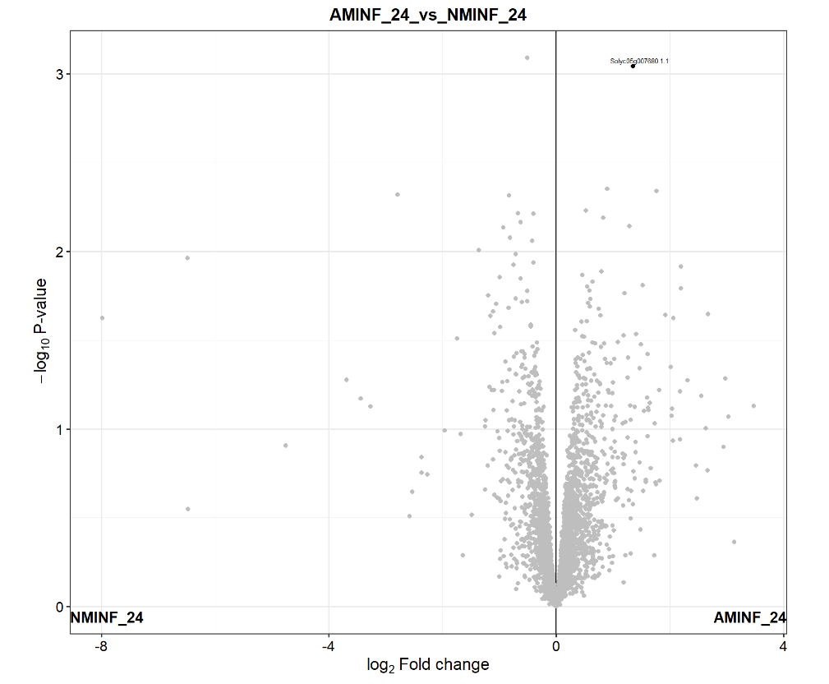
Phosphoproteome
VOLCANO PLOTS
These phosphorilated proteins could explain the induced resistance
Tyr

Slide 48
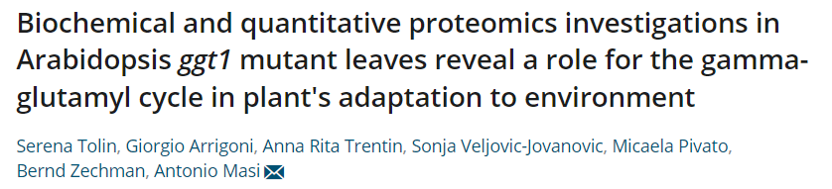
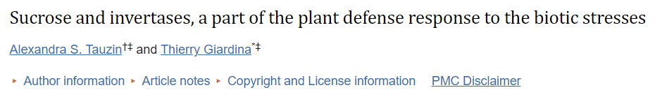
Phosphoproteome
PHOSPHORILATED PROTEINS WITH logFC>1.5 AND p-value>0.05
Solyc10g007410.4.1
Gamma-glutamyl hydrolase
doi: 10.3389/fpls.2014.00293
Solyc05g007680.1.1
Arabinanase/levansucrase/invertase

Slide 49
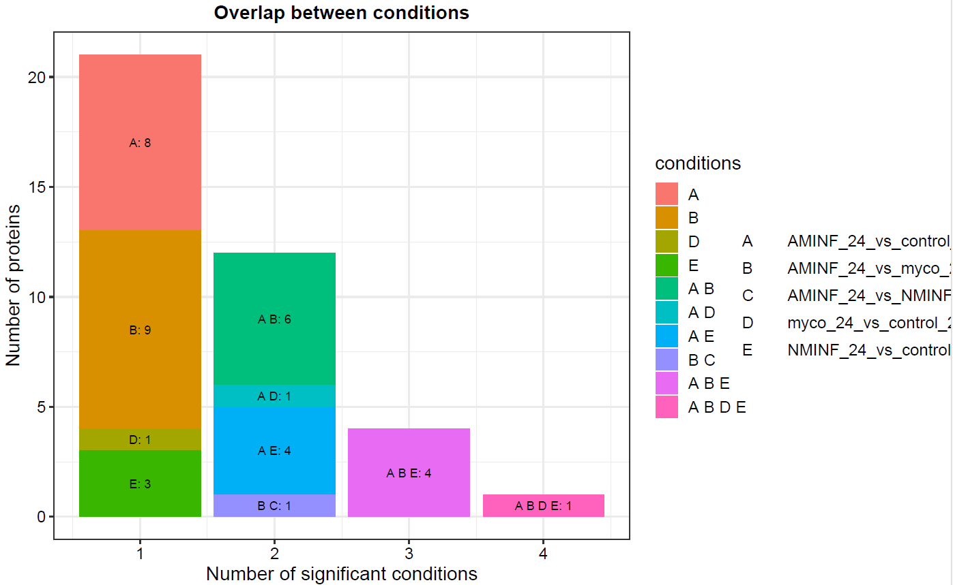
Phosphoproteome
Frequency plot of significant proteins between contrasts/conditions
Higher number of proteins in AMinf/NM and AMinf/AM

Slide 50

Phosphoproteome
Venn diagram upregulated proteins using LogFC>1.5 p<0.05
Enhanced resistance
Priming

Slide 51

Phosphoproteome
Venn diagram downregulated proteins using LogFC<-1.5 p<0.05

Slide 52
Phosphoproteome
Phosphorylated proteins filtered by |logFC |>1.5 (<-1.5) and FDR>0.5
ID | Shortname | Fuction | Description | AM/NM | AM inf/ AM | AM inf/NM | AM inf/NM inf | NM inf/ NM
Solyc01g111980.3.1 | LHT8 | Solute transport | Lysine histidine transporter-like 8
Solyc08g081190.3.1 | PIP1.5 | Solute transport | plasma membrane intrinsic protein 1.5
Solyc02g082950.3.1 | TBL34 | Cell wall organisation | Protein trichome birefringence-like 34
Solyc10g007410.4.1 | GGHA | Hydrolases | Gamma-glutamyl hydrolase
Solyc07g052150.4.1 | STPSs | Lyases | Sesquiterpene synthase
Solyc08g029000.3.1 | LOX | Redox homeostasis | Lipoxygenase
Solyc08g068710.1.1 | THT | Polyamine metabolism | Tyramine n-hydroxycinnamoyl transferase
Solyc10g079850.2.1 | AP5B | Vesicle trafficking | AP-5 complex subunit beta-like protein
Solyc04g077440.4.1 | SQLE | Oxidoreductases | Squalene epoxidase
Solyc05g018300.3.1 | PP2C-CNBKDP | Phosphorylation | Protein phosphatase 2C and cyclic nucleotide-binding/kinase domain-containing protein
Solyc06g008130.4.1 | PKMTs | Chromatin organisation | SET-domain containing protein lysine methyltransferase family protein
Solyc04g007250.1.1 | TP | Not assigned | transmembrane protein
Solyc09g011410.4.1 | Ctr | Not assigned | Copper ion transmembrane transporter
Solyc04g005350.3.1 | GR-RBP3 | Not assigned | Glycine-rich RNA-binding protein 3, mitochondrial
Solyc05g007680.1.1 | A0A4S9G124_AURPU | Not assigned | Arabinanase/levansucrase/invertase
Solyc08g079700.3.1 | zf-A20/1 | Not assigned | Zinc finger A20 and A.1
Solyc03g160470.1.1 | DUF3511 | Not assigned | DUF3511 domain-containing protein

Slide 53
Phosphoproteome
ENRICHMENT ANALYSIS
logFC<-1.5
Filtered by |logFC |>1.5 (<-1.5) and FDR>0.5
logFC>1.5

Slide 54
logFC<-1.5
logFC>1.5

Slide 55
logFC<-1.5
Phosphoproteome
Enritchment filtered by |logFC |>1.5 (<-1.5) and FDR>0.5
logFC>1.5
Fuction | AM/NM | AM inf/AM | AM inf/NM | AMinf/NMinf | NM inf/NM
PROTEIN BIOSYNTHESIS (PB)
PB. RIBOSOME BIOGENESIS
PB. LARGE RIBOSOMAL SUBUNIT (LSU)
PB. LARGE RIBOSOMAL SUBUNIT (LSU).LSU PROTEOME
PB. SMALL RIBOSOMAL SUBUNIT (SSU)
PB. SMALL RIBOSOMAL SUBUNIT (SSU).SSU PROTEOME
PROTEIN HOMEOSTASIS.UBIQUITIN-PROTEASOME SYSTEM
CARBOHYDRATE METABOLISM.SUCROSE METABOLISM
OXIDOREDUCTASE ACTING ON PAIRED DONOR (O2)
COENZYME METABOLISM.CHLOROPHYLL METABOLISM
OXIDOREDUCTASE CH-CH GROUP OF DONOR
CHROMATIN ORGANISATION. EPIGENETIC STATE REGULATION
CHROMATIN ORGANISATION. DNA METHYLATION REGULATION
RNA BIOSYNTHESIS.ORGANELLE MACHINERY
HYDROLASES. GLYCOSYLASE

Slide 56
ENZYMOMICS
Who performed the analysis:
24 hpi
Dr. Julia Pastor Fernández
HTML: https://github.com/NIB-SI/UJI-Omics-phd/blob/main/_I_UJI-Omics-phd/_S_multiOmicsIntegra/_A_07_Targeted-R/scripts/01_log2FC.html
TABLE LogFC p<0.05 https://github.com/NIB-SI/UJI-Omics-phd/blob/main/_I_UJI-Omics-phd/_S_multiOmicsIntegra/_A_07_Targeted-R/output/Enzymes.0.05_fdr.xlsx

Slide 57


OBTAINING logFC AND P-values
(Maria M., and Maja Z.)
Input
Enzyme levels
Welch’s t-test with fdr correction
t-test
Output
LogFC + P-value
Filtered P<0.05

Slide 58

HEATMAP ENZYMES WITHIN CONTRASTS
Citrate synthase involved in biosynthesis of anthocyanins and other secondary metabolites
Interactive Heatmap https://github.com/NIB-SI/UJI-Omics-phd/blob/main/_I_UJI-Omics-phd/_S_multiOmicsIntegra/_A_07_Targeted-R/output/With%20p-adj%20fdr/Enzy24.html

Slide 59
METABOLOMICS
Who performed the analysis:
María Manresa Grao
Plant immunity and Biochemistry
Universitat Jaume I
24 hpi
HTML: https://github.com/NIB-SI/UJI-Omics-phd/blob/main/_I_UJI-Omics-phd/_S_multiOmicsIntegra/_A_07_Targeted-R/scripts/02_log2FC.html
TABLE LogFC p<0.05 https://github.com/NIB-SI/UJI-Omics-phd/blob/main/_I_UJI-Omics-phd/_S_multiOmicsIntegra/_A_07_Targeted-R/output/Metabol_filtered_0.05_fdr.xlsx

Slide 60


OBTAINING logFC AND P-values
(Maria M., and Maja Z.)
Input
Intensity of peaks
Welch’s t-test with fdr correction
t-test
Output
LogFC + P-value
Filtered P<0.05

Slide 61


sPLSDA USING ALL SIGNALS FROM THE METABOLOME
24 hpi
48 hpi
AM plants responds faster upon Botrytis infection

Slide 62

HEATMAP WITH ONLY METABOLITES IDENTIFIED WITHIN CONTRASTS AT 24 HPI
Most of the metabolites are flavonoids, phenylpropanoids and precursors
Interactive heatmap: https://github.com/NIB-SI/UJI-Omics-phd/blob/main/_I_UJI-Omics-phd/_S_multiOmicsIntegra/_A_07_Targeted-R/output/With%20p-adj%20fdr/Metabol24.html

Slide 63

Flavonoids are also important in mycorrhizal citrus plants
Priming?
Priming of flavonoids?

Slide 64
Pathways of metabolites identified filtered by logFC >1.5 (<-1.5) and P<0.05
Up accumulated
Down accumulated
Flavonoids doing something as always

Slide 65
Only metabolites identified filtered by logFC >1.5 (<-1.5) and P<0.05
logFC<-1.5
logFC>1.5
Compound | Pathway | AM/NM | AM inf/AM | NM inf/NM | AM inf/NM | AM inf/NM inf
Quercetin-3-O-sophoroside | Biosynthesis of flavonoids
7,2'-dihydroxy-3',4'-dimethoxyisoflavane-7-O-glucoside | Biosynthesis of flavonoids
Eriocitrin | Biosynthesis of flavonoids
Narirutin | Biosynthesis of flavonoids
Spinosin | Biosynthesis of flavonoids
2'-Deoxyguanosine 5'-monophosphate | Purine metabolism
6-Hydroxypurine | Purine metabolism
Acanthoside B | Biosynthesis of lignans
Threonine | Biosynthesis of amino acids
Riboflavin | Riboflavin metabolism
1-Methylnicotinamide | Nicotinate and nicotinamide metabolism
4-Imidazoleacetate | Histidine metabolism
Light colours mean logFC>1 (<-1)

Slide 66

Only metabolites identified iltered by logFC >1.5 (<-1.5) and P<0.05 in AM inf/NM inf but 48 hpi
Important: Precursors of secondary metabolites up at 48 hpi
Coumarine, Thr, riboflavin, Phe 4-Coumaryl alcohol up at 48hpi in AMinf/NMinf

Slide 67
DiABLO (Mixomics)
(for 3 levels: Met, Enz, Pph; 4 replicates; 24 hpi)
HTML: https://github.com/NIB-SI/UJI-Omics-phd/blob/main/_I_UJI-Omics-phd/_S_multiOmicsIntegra/_A_10_mixOmics-R/scripts/01_DIABLO.html
(Maria M., and Maja Z.)

Slide 68
Input
Output
Density plots
Correlation plots
Correlation values between levels
Normalized data
(Changed IDs to Shortnames)
For Enz and Met performed Log2
MixOmics pipeline
R DATA MODEL https://github.com/NIB-SI/UJI-Omics-phd/blob/main/_I_UJI-Omics-phd/_S_multiOmicsIntegra/_A_10_mixOmics-R/output/01_DIABLO-Enz-Met-Pph_tune.MIR.RData
Tuning the number of features
(Using BBPARAM; tune.block.splsd)
Set number of components
(perf.diablo)
(n=3)
4 biological replicates for AMinf, NMinf and NM
3 biological relicates for AM
Final model
Plots
PLOTS https://github.com/NIB-SI/UJI-Omics-phd/tree/main/_I_UJI-Omics-phd/_S_multiOmicsIntegra/_A_10_mixOmics-R/scripts/01_DIABLO_figures/figure-html

Slide 69



CIRCLE CORRELATION PLOTS PAIRWISE PLS COMPARISONS
Top correlation features of each dataframe
Strongest correlation between pairs met and pph

Slide 70

DIAGNOSTIC PLOT

Slide 71

AM plants have different behaviour

Slide 72

ARROW PLOT

Slide 73

CORRELATION CIRCLE PLOT

Slide 74

CIRCOS PLOT
Cut-off 0.5
Lots of positive correlations between Met and Pph

Slide 75

CIRCOS PLOT
Cut-off 0.75

Slide 76

CLUSTERED IMAGE MAP

Slide 77


RELEVANCE NETWORKS
Relevance networks table
TABLE CORRELATION NETWORK https://github.com/NIB-SI/UJI-Omics-phd/blob/main/_I_UJI-Omics-phd/_S_multiOmicsIntegra/_A_10_mixOmics-R/output/01_DIABLO-Enz_Met_Pph.txt
Phenylpropanoids are positively correlated with LOX (JA)

Slide 78
NETWORKS
(Maria M., Ziva R., Maja Z., Marko P. and Carissa R.)
https://github.com/NIB-SI/UJI-Omics-phd/tree/main/_I_UJI-Omics-phd/_S_multiOmicsIntegra/_A_09_NetworksSKM-R/output/DiNAR-output

Slide 79


FIND ORTHOLOGS / TRANSLATIONS Sly-Ath
PLAZA
Selected proteins (Ath , Sly )
Using BLAST+orthofinder pipelines
28400 translations (1 Ath to several Sly)
HTML: https://github.com/NIB-SI/UJI-Omics-phd/blob/main/_I_UJI-Omics-phd/_S_multiOmicsIntegra/_A_06_Orthologues-R/scripts/01_ortho.html
Results: https://github.com/NIB-SI/UJI-Omics-phd/blob/main/_I_UJI-Omics-phd/_S_multiOmicsIntegra/_A_06_Orthologues-R/output/RBHresults.xlsx
=SI(Y([@[perc_identity]] >= 50, (Y(Y([@[q_len/s_len]] <=1.5, [@[q_len/s_len]] >= 0.5), O(Y([@[q_len/a_len]]<=1.5, [@[q_len/a_len]] >= 0.5), Y([@[s_len/a_len]]<=1.5,[@[s_len/a_len]] >= 0.5))))), VERDADERO)

Slide 80
OPTION 1. PRIORITIZED TOMATO ON PSS Ath BASED ID
P-value< 0.05
Input
Output
28400 translations
DEs (Filtered LogFC)
PSS nodes (Ath based) 613 (nodes) 430 Ath genes
Prioritise most responsive Sly ID to Ath ID
Prioritised tomato PSS
(Prioritised PSS-DiNAR input) 165 Sly DEGs
HTML: https://github.com/NIB-SI/UJI-Omics-phd/blob/main/_I_UJI-Omics-phd/_S_multiOmicsIntegra/_A_09_NetworksSKM-R/scripts/01_geneID_to_PSS-Ath.html
P-value< 0.05
OPTION 2. PRIORITIZED TOMATO TO CKN Ath
Input
Output
28400 translations
DEs (Filtered LogFC)
Old CKN nodes 20011 nodes (Ath based)
Prioritise most responsive Sly ID to Ath ID
Read those IDs present in PSS
Prioritised tomato CKN
(Prioritised CKN-DiNAR) 3074 (DEGs)
HTML: https://github.com/NIB-SI/UJI-Omics-phd/blob/main/_I_UJI-Omics-phd/_S_multiOmicsIntegra/_A_09_NetworksSKM-R/scripts/03_geneID_to_old-CKN.html

Slide 81
OPTION 3. Filtered old CKN (23192 edges)
Input
Old CKN edges
Prioritised tomato CKN
(Prioritised CKN-DiNAR)
Output
Find edges with DE in both genes
Filtered for cytoscape
https://github.com/NIB-SI/UJI-Omics-phd/blob/main/_I_UJI-Omics-phd/_S_multiOmicsIntegra/_A_09_NetworksSKM-R/scripts/04_filter_old-CKN.html
https://github.com/NIB-SI/UJI-Omics-phd/tree/main/_I_UJI-Omics-phd/_S_multiOmicsIntegra/_A_09_NetworksSKM-R/output/CKN-DiNAR-input/prioritised
LionessR It’s hard to define cutoffs
https://github.com/NIB-SI/UJI-Omics-phd/blob/main/_I_UJI-Omics-phd/_S_multiOmicsIntegra/_A_09_NetworksSKM-R/scripts/05_lionessR.html

Slide 82

OPTION 5 . ZIVA’S CUSTOM NETWORKS
Input
Output
https://github.com/NIB-SI/UJI-Omics-phd/blob/main/_I_UJI-Omics-phd/_S_multiOmicsIntegra/_A_09_NetworksSKM-R/output/cytoscape/network_phosphoproteomics_Dulcenombre_v2023-07-21.cys
New CKN
Ranks 1-3 3254 nodes 32350 edges
Filters ranks 1-2 1396 nodes 4484 edges
On phosphoproteomics level

Slide 83


PSS at Ath ID
RNA-seq
004_myco_infected_48h-mycorrhized_48h.txt
ICS from SA makes sense Botrytis-Necrotroph-JA
LOX, PR3- JA
Ethylene- Lidoy’s paper (MIR against spodoptera mediated by ET singnaling)

Slide 84


RNA-seq
008_myco_infected_48h-control_48h.txt
Induction of JA, Et just like in the first contrast
Induction of ET while blocking SA (negative crosstalk)

Slide 85


PSS Sly based
Biochemical network
PSS+biochemical network
Translate to Ath;
From Ath to Solyc
187 reactions by hand connecting Met-Met, Enz-Enz and Enz-Met
1073 reactions on clade level
TABLE with logFC filtered by 0.05 https://github.com/NIB-SI/UJI-Omics-phd/blob/main/_I_UJI-Omics-phd/_S_multiOmicsIntegra/_A_09_NetworksSKM-R/output/FC_all_analysis_MM_2023-08-28.xlsx
Triplicate Solyc to Pro, RNA and Pph
TABLE with edge and nodes PSS+biochem https://github.com/NIB-SI/UJI-Omics-phd/blob/main/_I_UJI-Omics-phd/_S_multiOmicsIntegra/_A_09_NetworksSKM-R/input/BioChemReactions_Maria_130923.xlsx
https://github.com/NIB-SI/UJI-Omics-phd/tree/main/_I_UJI-Omics-phd/_S_multiOmicsIntegra/_A_09_NetworksSKM-R/output PSS-Sly_edges.txt and PSS-Sly_nodes.txt

Slide 86
Conclusions
Mycorrhizal symbiosis have an huge impact on Pro, Pph, Met and Enz profile
Protein and phosphorilated proteins that participate on defense are accumulated in AM inf plants. These proteins could explain the enhance resistanced observed.
Precursors of phenylpropanoids pathway as well as flavonoids are accumulated in AM inf plants.
Phosphoproteomics and metabolomics are positively correlated.

Slide 87
FUTURE PLANTS
Run DiABLO (Mixomics) for all 5 levels
Custom Biochemical networks
Join the network with PSS Sly based

Slide 88

Thank you for your attention!

Slide 89


Slide 90

Pph

Slide 91

CLUSTER PLOTING USING GOWER’S DISTANCE
Pph
Impact of infection

Slide 92

CLUSTER PLOTING USING GOWER’S DISTANCE
Pro

Slide 93

Pro

Slide 94

CIRCLE CORRELATION PLOTS Met vs PPh WITH SHORTNAMES

Slide 95

How is the establishment of AM symbiosis?

Slide 96

CHOOSING THE NUMBER OF COMPONENTS IN block.plsda using perf()
Centroid.distance
3 components

